Slide 1
Descriptive Statistical Measures

Slide 2
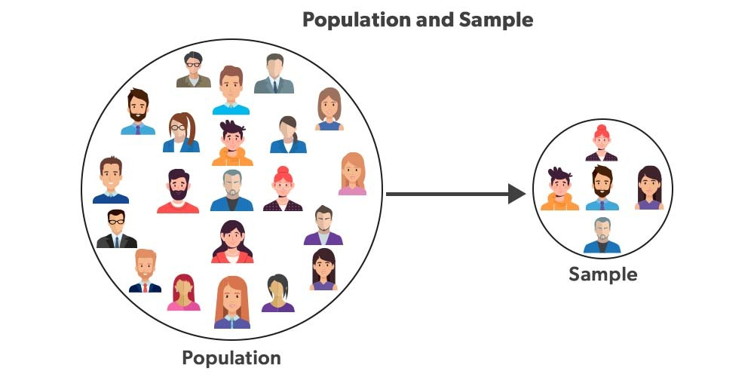
Population versus Sample

Slide 3
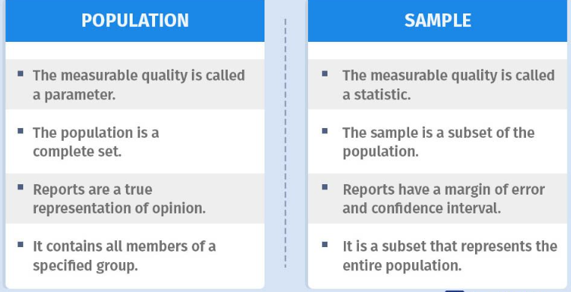
Population versus Sample

Slide 4
Measures of Location
Measures of Location: A single value that represents the “centering” of a set of data, e.g. average
Also called Measures of Central Tendency
Example: Marks obtained by 10 students, arranged in an ascending order … 45,56,61,65,68,71,73,79,82,88,91
Possible measure of location:
45,56,61,65,68, 71, 73,79,82,88,91
Measures of Location
Mean
Mode
Median

Slide 5
Basic Usage
Mean: Better if the data is normally distributed and there are no outliers
Median: Better when the data is skewed (has extreme values)
Mode: Useful for identifying the most common value or values in a dataset

Slide 6
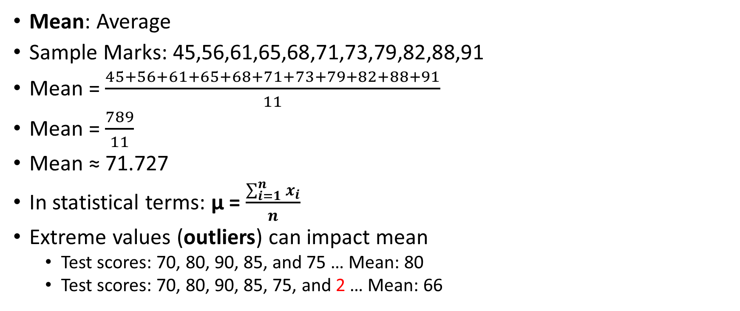
Mean
Mean: Average
Sample Marks: 45,56,61,65,68,71,73,79,82,88,91
Mean = $\frac{45+56+61+65+68+71+73+79+82+88+91}{11}$
Mean = $\frac{789}{11}$
Mean ≈ 71.727
In statistical terms: μ = $\frac{\sum_{i=1}^{n}{x_{i}}}{n}$
Extreme values (outliers) can impact mean
Test scores: 70, 80, 90, 85, and 75 … Mean: 80
Test scores: 70, 80, 90, 85, 75, and 2 … Mean: 66

Slide 7
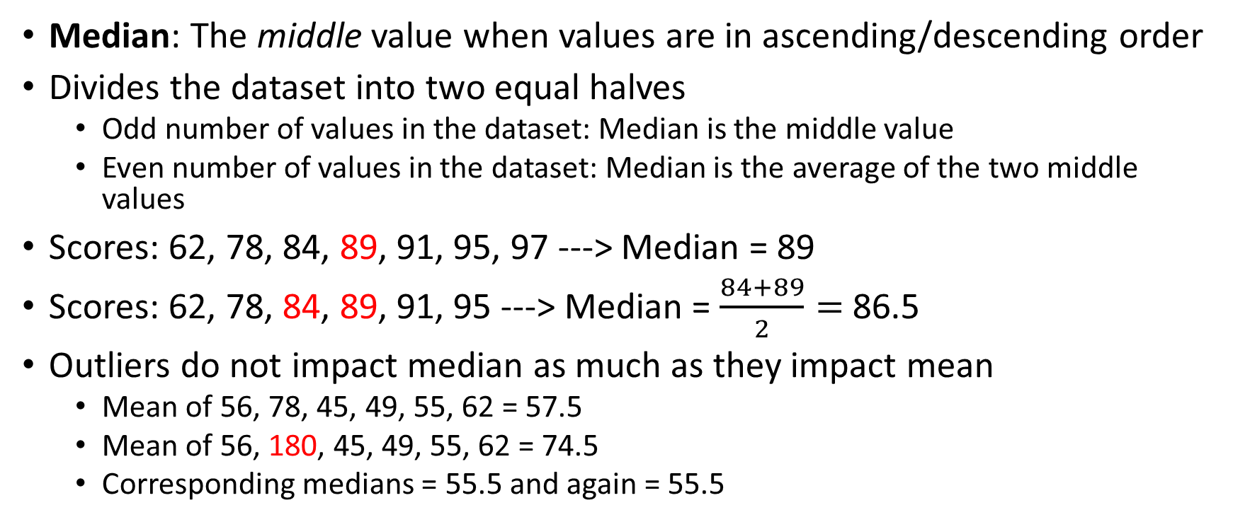
Median
Median: The middle value when values are in ascending/descending order
Divides the dataset into two equal halves
Odd number of values in the dataset: Median is the middle value
Even number of values in the dataset: Median is the average of the two middle values
Scores: 62, 78, 84, 89, 91, 95, 97 ---> Median = 89
Scores: 62, 78, 84, 89, 91, 95 ---> Median = $\frac{84+89}{2}=$86.5
Outliers do not impact median as much as they impact mean
Mean of 56, 78, 45, 49, 55, 62 = 57.5
Mean of 56, 180, 45, 49, 55, 62 = 74.5
Corresponding medians = 55.5 and again = 55.5

Slide 8
Mode
Mode: The value that occurs most frequently in a dataset
Data: 62, 78, 84, 89, 91, 95, 97, 89, 91, 89
Frequency: 62: 1, 78: 1, 84: 1, 89: 3, 91: 2, 95: 1, 97: 1
Mode = 89
What if there are multiple values with the same highest frequency?: Multimodal data
If we have two modes: bi-modal
If we have three modes: tri-modal
Not used much in practice

Slide 9
Measures of Dispersion
Spread: How and by how much, our data set is spread out around its center?
Called Measures of Dispersion or Scatter
Measures of Dispersion
Range
Variance
Standard Deviation

Slide 10
Range
Range: Difference between the maximum value and the minimum value in the data set
Affected by outliers
Example: 8, 11, 5, 9, 7, 6, 2500
Range = Max – Min = 2500 – 5 = 2495, which is quite meaningless
Solution: Inter Quartile Range (IQR)
But first, we need to understand percentile and quartile
Range
Minimum
Maximum

Slide 11
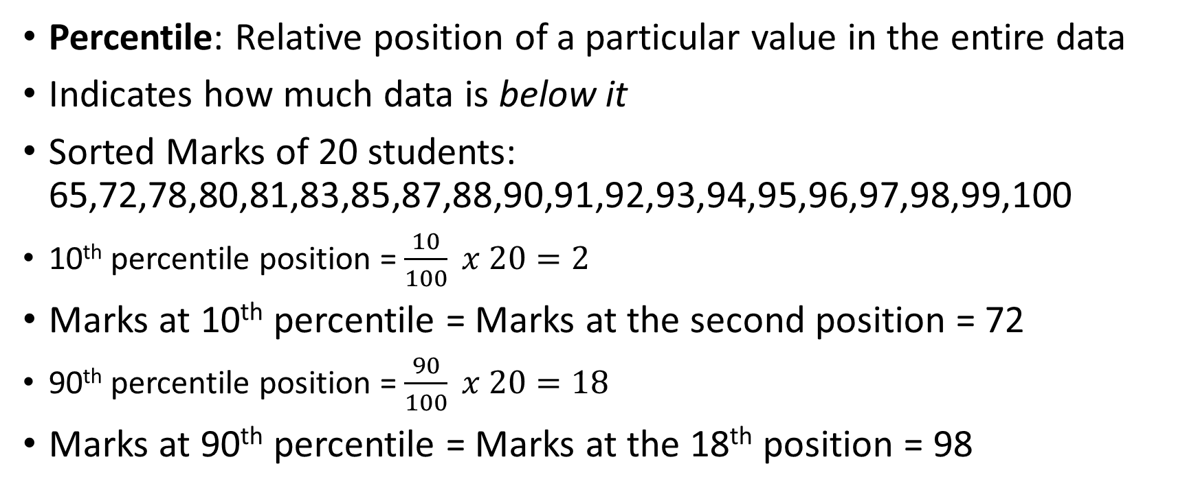
Percentile
Percentile: Relative position of a particular value in the entire data
Indicates how much data is below it
Sorted Marks of 20 students: 65,72,78,80,81,83,85,87,88,90,91,92,93,94,95,96,97,98,99,100
10th percentile position = $\frac{10}{100} x 20=2$
Marks at 10th percentile = Marks at the second position = 72
90th percentile position = $\frac{90}{100} x 20=18$
Marks at 90th percentile = Marks at the 18th position = 98

Slide 12
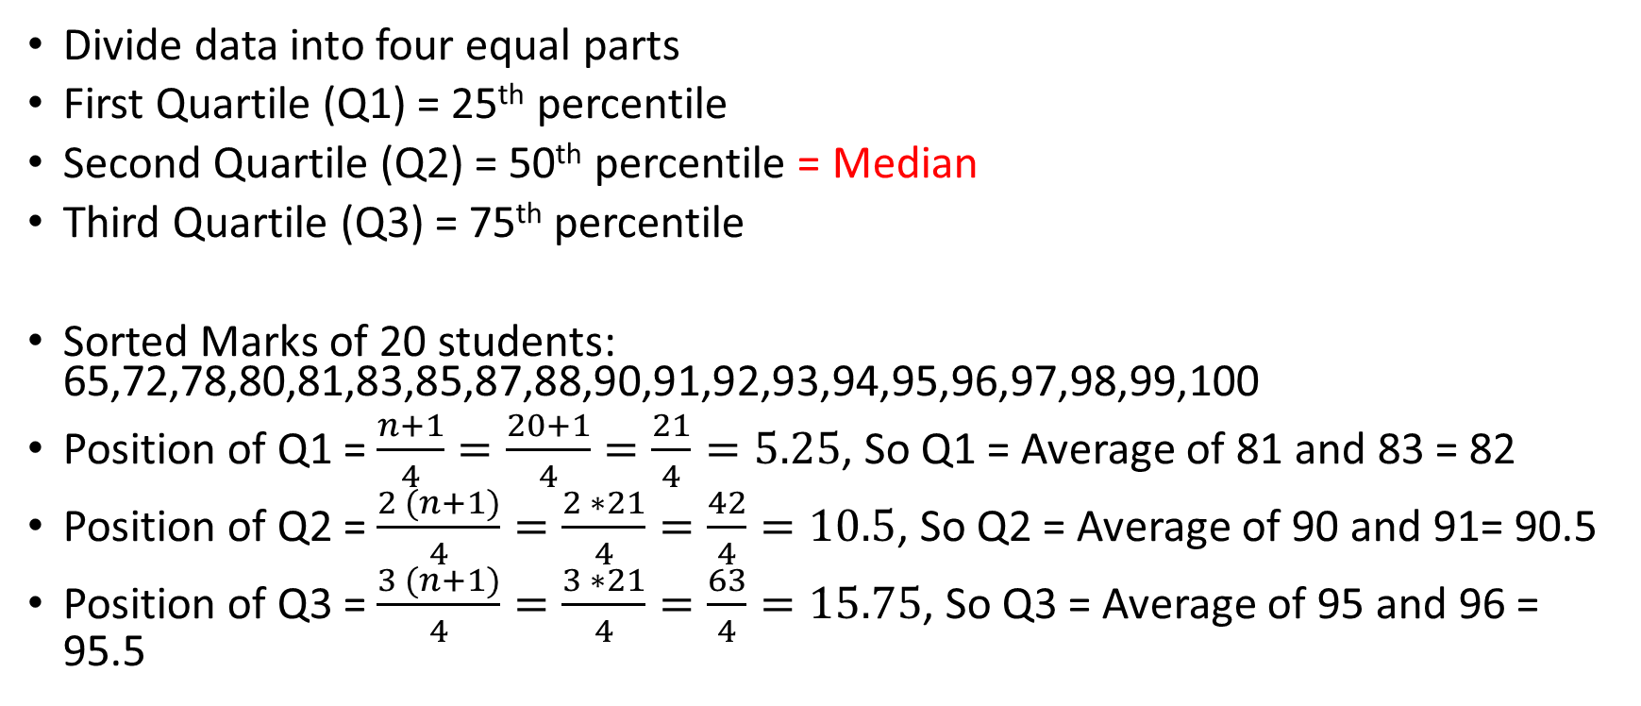
Quartile
Divide data into four equal parts
First Quartile (Q1) = 25th percentile
Second Quartile (Q2) = 50th percentile = Median
Third Quartile (Q3) = 75th percentile
Sorted Marks of 20 students: 65,72,78,80,81,83,85,87,88,90,91,92,93,94,95,96,97,98,99,100
Position of Q1 = $\frac{n+1}{4}=\frac{20+1}{4}=\frac{21}{4}=5.25$, So Q1 = Average of 81 and 83 = 82
Position of Q2 = $\frac{2 (n+1)}{4}=\frac{2 ∗21}{4}=\frac{42}{4}=10.5$, So Q2 = Average of 90 and 91= 90.5
Position of Q3 = $\frac{3 (n+1)}{4}=\frac{3 ∗21}{4}=\frac{63}{4}=15.75$, So Q3 = Average of 95 and 96 = 95.5

Slide 13
Inter Quartile Range (IQR)
Inter Quartile Range (IQR) = Q3 – Q1
In the given example,
IQR = Q3 – Q1 = 95.5 – 82 = 13.5
IQR handles outliers better than range, since the extreme values at both the ends are ignored in IQR
Also, it focuses on the middle part of the data
Since it uses percentiles rather than actual values, it is less affected by skewed data (See Skewness)

Slide 14
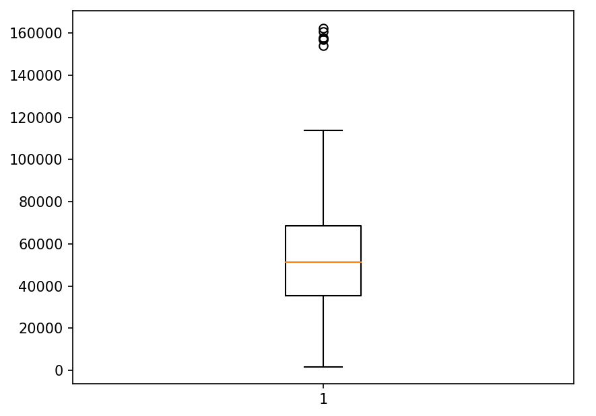
IQR and Box Plots for Outlier Detection
Maximum length of the whisker is 1.5 times that of IQR. Points beyond it are outliers.
Any data point below Q1 - 1.5 * IQR or above Q3 + 1.5 * IQR is considered an outlier
Outliers
Maximum (100%)
Whiskers
Q3 (75%)
Box represents middle 50% of the data points.
Short vertical box: Data is condensed around the median, Long box: Data points are not close to the median
Q2 (Median) (50%)
IQR
Q1 (25%)
Minimum

Slide 15
Variance
Variance = How far are data points from their mean?
High variance = Data is more scattered from its mean
Low variance = Data is less scattered from mean
Variance calculation:
Find the mean of the given data set
Subtract the mean from each value and square the result
The average of these squared values is the variance

Slide 16
Variance Example
Consider data values 5, 7, 10, 12, and 15
Step 1: Mean: (5 + 7 + 10 + 12 + 15) / 5 = 9.8
Step 2: Subtract mean from each number and square the result
(5 - 9.8)^2 = 20.24
(7 - 9.8)^2 = 6.76
(10 - 9.8)^2 = 0.04
(12 - 9.8)^2 = 5.44
(15 - 9.8)^2 = 27.04
Step 3: Add up the squared differences and divide by the total number of numbers: (20.24 + 6.76 + 0.04 + 5.44 + 27.04) / 5 = 11.12 = Variance

Slide 17
Why are the Differences Squared?
If we do not do this, then the positive and negative differences may cancel each other and we may not be able to find how the data points are dispersed from the mean
Example: Consider marks of 5 students: 55, 60, 65, 54, 64
Mean: 59.6, Variance: 20.24
But if we do not square the differences, what will happen?
Marks | Marks - Mean | (Marks - Mean) Squared
55 | -4.6 | 21.16
60 | 0.4 | 0.16
65 | 5.4 | 29.16
54 | -5.6 | 31.36
64 | 4.4 | 19.36
Mean | (Marks - Mean) / 5 | ((Marks - Mean) Squared)) / 5
59.6 | 0.00 | 20.24
Variance

Slide 18
Limitation of Variance: How to Quantify?
Quantifying/measuring variance is tough
Example: Consider marks of 10 students: 32, 39, 44, 56, 56, 63, 71, 72, 81, 89
Mean: 60.3, Variance: 306.81
Variance seems to be high, but it does not convey any meaningful information beyond this
This is a limitation of variance

Slide 19
Standard Deviation
Standard deviation = Square root of variance
The scale of variance is not to the scale of the original data
But the scale of standard deviation is the same as scale of the original data
Variance: Difficult to interpret, Standard deviation: Easy to interpret

Slide 20
Standard Deviation Example
Example: Calculate the standard deviation of 2, 1, 3, 2, and 4.
Mean: 2 + 1 + 3 + 2 + 4 = 12 / 5 = 2.4
Subtract mean from each value: (2-2.4), (1-2.4), (3-2.4), (2-2.4), (4-2.4) = -.04, -1.4, 0.6, -0.4, 1.6
Square each value: 0.16, 1.96, 0.36, 0.16, 2.56
Calculate their average to get the Variance: (0.16 + 1.96 + 0.36 + 0.16 + 2.56) / 5 = 5.2 / 5 = 1.04
Square root of 1.04 = 1.01 = Standard deviation

Slide 21
Standard Deviation: True Indicator of Homogeneous/Heterogeneous Data
Consider cholesterol levels of two groups of people:
A = 125, 118, 121, 123, 119, 122, 117, 121, 124, 116, 120, 122, 119, 124, 118, 120, 123, 122, 118, 121
Mean = 120 mg/dL, SD = 5 mg/dL
Most close to the mean (Fit)
B = 150, 90, 115, 145, 118, 112, 135, 121, 117, 122, 119, 128, 115, 145, 120, 90, 155, 135, 122, 115
Mean = 120 mg/dL, SD = 30 mg/dL
Some close to the mean (Fit), some away from the mean (Unfit)

Slide 22
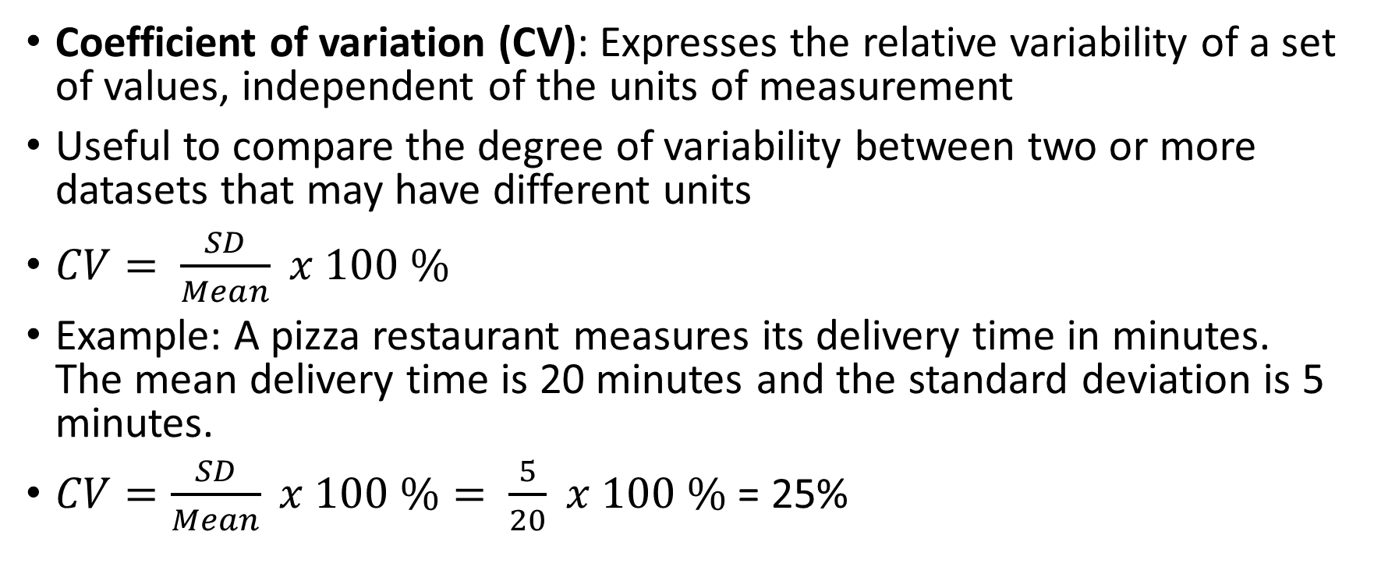
Coefficient of Variation (CV)
Coefficient of variation (CV): Expresses the relative variability of a set of values, independent of the units of measurement
Useful to compare the degree of variability between two or more datasets that may have different units
$CV= \frac{SD}{Mean} x 100 \%$
Example: A pizza restaurant measures its delivery time in minutes. The mean delivery time is 20 minutes and the standard deviation is 5 minutes.
$CV=\frac{SD}{Mean} x 100 \%= \frac{5}{20} x 100 \%$ = 25%

Slide 23
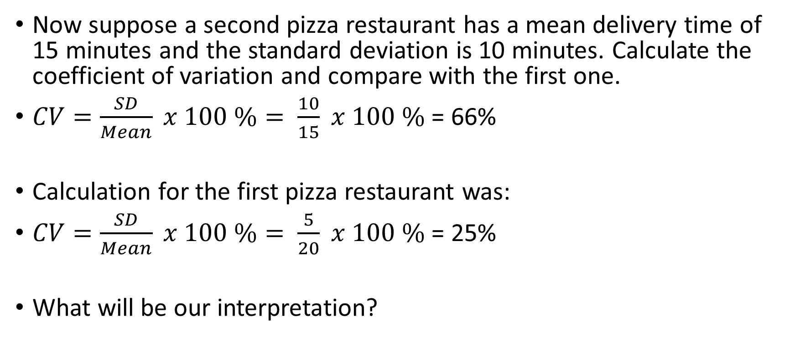
Coefficient of Variation (CV)
Now suppose a second pizza restaurant has a mean delivery time of 15 minutes and the standard deviation is 10 minutes. Calculate the coefficient of variation and compare with the first one.
$CV=\frac{SD}{Mean} x 100 \%= \frac{10}{15} x 100 \%$ = 66%
Calculation for the first pizza restaurant was:
$CV=\frac{SD}{Mean} x 100 \%= \frac{5}{20} x 100 \%$ = 25%
What will be our interpretation?

Slide 24
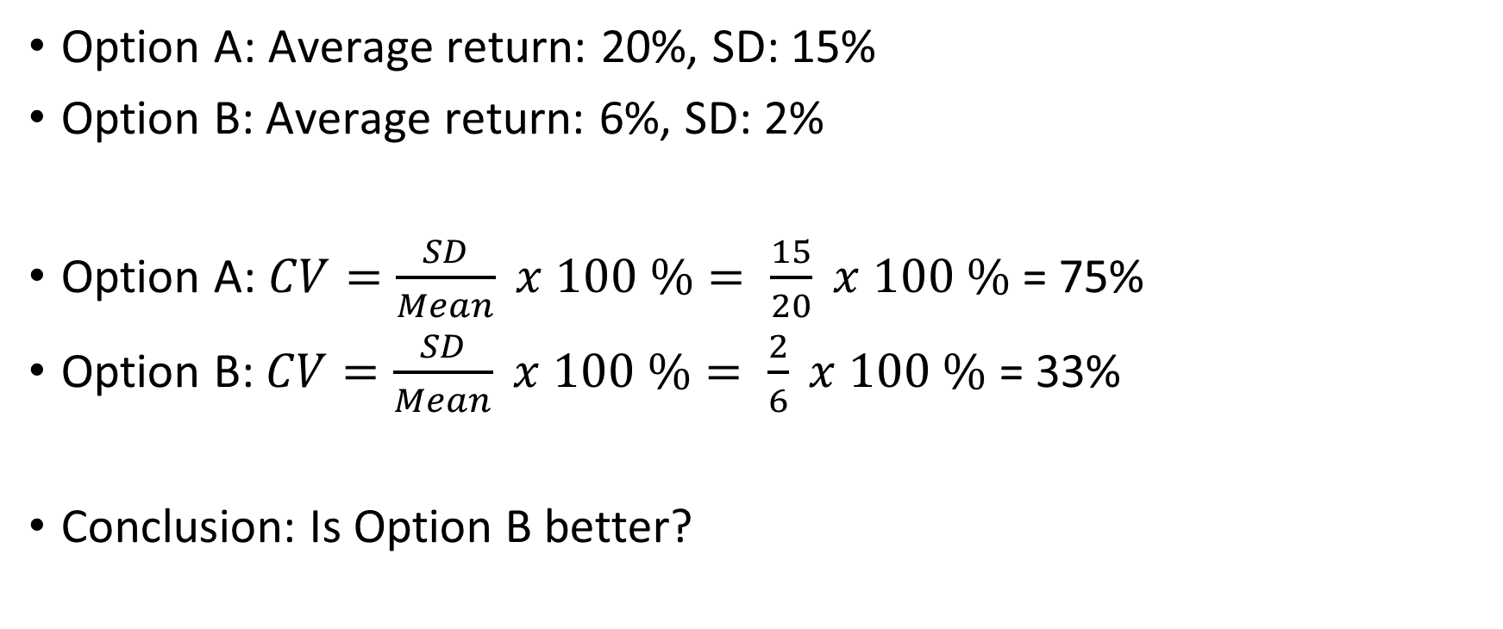
Making Investment Decisions
Option A: Average return: 20%, SD: 15%
Option B: Average return: 6%, SD: 2%
Option A: $CV=\frac{SD}{Mean} x 100 \%= \frac{15}{20} x 100 \%$ = 75%
Option B: $CV=\frac{SD}{Mean} x 100 \%= \frac{2}{6} x 100 \%$ = 33%
Conclusion: Is Option B better?

Slide 25
Population and Sample, Probability Theory

Slide 26
Descriptive and Inferential Statistics
Descriptive statistics: Describe characteristics of a dataset
Examples: Mean, mode, median, Variance, SD, Skewness, Kurtosis
Only describes the current data – No relationship with any other data
Inferential statistics: Draw inferences/conclusions using a dataset or sample about the population
Examples: P-value, T/F/Chi-square value, Confidence intervals, Hypothesis testing
Use specific observations to draw general conclusions

Slide 27
Population
Population: Entire group or collection of individuals, items, or data points
Population parameters: Numerical values that describe a population
Example: Average marks obtained by all the students, median income of the population, Standard deviation in the blood sugar level of all the patients in a hospital
Symbols for population parameter: μ (mean), σ (standard deviation), π (proportion)

Slide 28
Sample
Sample: Subset of the population that is selected for data collection and analysis
Should be randomly selected
Sample statistics: Used to estimate population parameters (Example: Sample mean to estimate population parameter of mean)
Technique of choosing sample from the population is called sampling

Slide 29
Why Sampling?
Consider a school of 1000 students
The school itself is the population
Its characteristics such as the average height of the students are population parameters
We can measure the actual height of all 1000 students to get the exact average (parameter)
But might be easier to take a sample of 100 students and estimate the average based on their heights (statistic)

Slide 30
Univariate Sampling
Univariate sampling: Analysis of data that consists of a single variable or characteristic
Examples:
Analyzing the ages of individuals in a population
Examining the heights of a sample of students
Studying the test scores of students in a class
Useful analysis: Descriptive statistics such as mean, mode, median, variance, standard deviation
Visualize using: Histograms, box plots, summary statistics

Slide 31
Bivariate Sampling
Bivariate sampling: Analysis of data that consists of two variables or characteristics to find how they are related
Examples:
Amount of time spent studying (variable 1) and the test scores achieved (variable 2)
Education (variable 1) and the Income level (variable 2) in a population
Useful analysis and visualization: Scatterplots, correlation coefficients, regression analysis, cross-tabulations

Slide 32
Resampling
Resampling: Modifying a dataset by changing its size or composition
Two main resampling methods: Bootstrapping and Cross-validation
Bootstrapping: Generating multiple new samples (called bootstrap samples) from the original dataset by randomly selecting data points with replacement – Useful in estimating population parameters, regression analysis
Cross-validation: Dividing the dataset into a training set and a testing set, and iteratively training and evaluating the model on different combinations of these subsets – Useful in machine learning model evaluation

Slide 33
Sample Space and Events

Slide 34
Sample Space and Events
Sample space: All the possible outcomes of an experiment
Event: A subset of the sample space
Sample space (S)
Event (E)

Slide 35
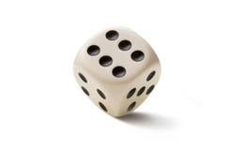


Sample Spaces and Events
Rolling a die/dice is a random experiment - the actual outcome cannot be predicted.
We can assign a number to each outcome/event, called its probability, which tells us how likely that outcome will occur.
The sample space associated with a random experiment is the set of all possible outcomes.
An event is a subset of the sample space.

Slide 36
Sample Space: Examples
Question: Construct a sample space for the experiment that consists of rolling a single die. Find the events that correspond to the phrases “an even number is rolled” and “a number greater than two is rolled.”
Answer (Diagram on the next page):
Sample space S={1,2,3,4,5,6}
Event “an even number is rolled” E={2,4,6}
Event “a number greater than two is rolled” T={3,4,5,6}

Slide 37
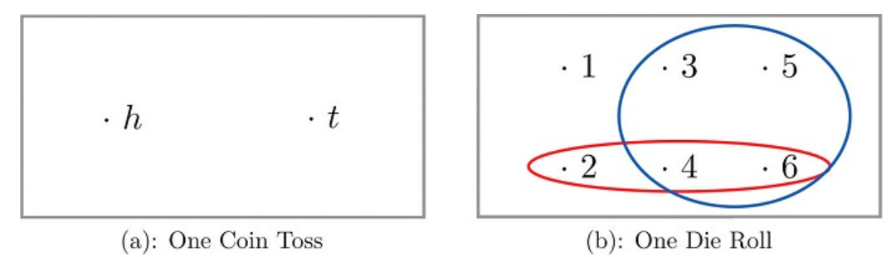
Sample Space: Examples – Venn Diagram
Sample space: Rectangle
Outcomes: Points within the rectangle
Events: Ovals

Slide 38
Probability

Slide 39
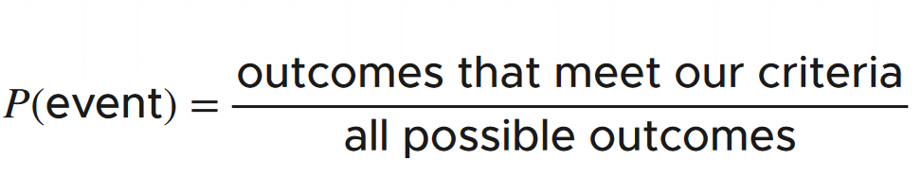
Probability Definition
Probability: How likely it is that something will occur?
Written as a number or fraction (e.g. 0.5 or 50%)
Example:
What is the probability that it will rain today?
Sample space (S) = {R, NR}
P(NR) = 1 / 2 = 0.5 or 50%
This is our sample space

Slide 40
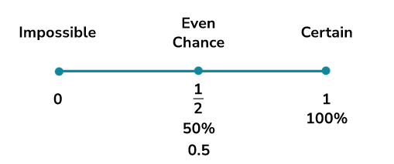
Probability Measurement
0: 0% chance that something will occur (Impossible)
Between 0 and 0.5: Something is more likely not to occur
Exactly 0.5: An equal chance of the event occurring versus not occurring
Between 0.5 and 1: Something is more likely to occur than not
1: 100 % chance that something will occur (Guaranteed)

Slide 41

Example: Flipping a coin
Result: Heads or Tails
P(H) = $\frac{1}{2}$
P(T) = $\frac{1}{2}$
Sample space
H T

Slide 42

Example: Flipping a coin Twice
Sample space
HH HT TH TT
Sample space: {HH, HT, TH, TT}
P(HH): $\frac{1}{4}$= 25%
P(At least one Head): $\frac{3}{4}$ = 75%

Slide 43

Example: Drawing a queen from deck of playing cards
Number of cards in a deck: 52
Number of queen cards: 4
P(Queen Card) = $\frac{4}{52}$ = $\frac{1}{13}$

Slide 44
Joint, Conditional, Marginal Probability

Slide 45
Adding Conditions to Probability
Consider this statement:
What is the chance that this patient has diabetes?
We may think about some answer
Now consider an addition:
What is the chance that this patient has diabetes, given that both her parents have diabetes?

Slide 46
Basic Terms
Marginal probability: Probability of an event irrespective of the outcome of another variable: P(A)
Joint probability: Probability of two events occurring simultaneously: P(A ∩ B)
Conditional probability: Probability of a second event happening given that the first one has happened: P(A|B)
Our focus: Conditional probability

Slide 47
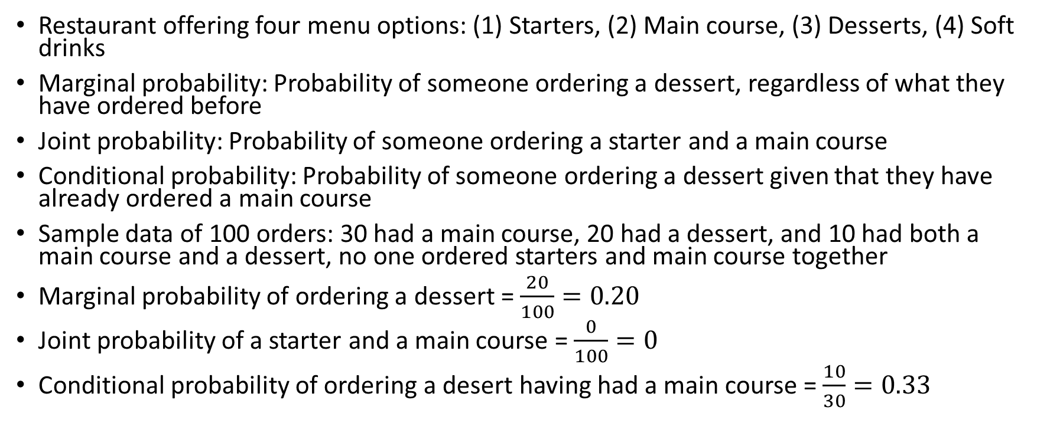
Example
Restaurant offering four menu options: (1) Starters, (2) Main course, (3) Desserts, (4) Soft drinks
Marginal probability: Probability of someone ordering a dessert, regardless of what they have ordered before
Joint probability: Probability of someone ordering a starter and a main course
Conditional probability: Probability of someone ordering a dessert given that they have already ordered a main course
Sample data of 100 orders: 30 had a main course, 20 had a dessert, and 10 had both a main course and a dessert, no one ordered starters and main course together
Marginal probability of ordering a dessert = $\frac{20}{100}=0.20$
Joint probability of a starter and a main course = $\frac{0}{100}=0$
Conditional probability of ordering a desert having had a main course = $\frac{10}{30}=0.33$

Slide 48
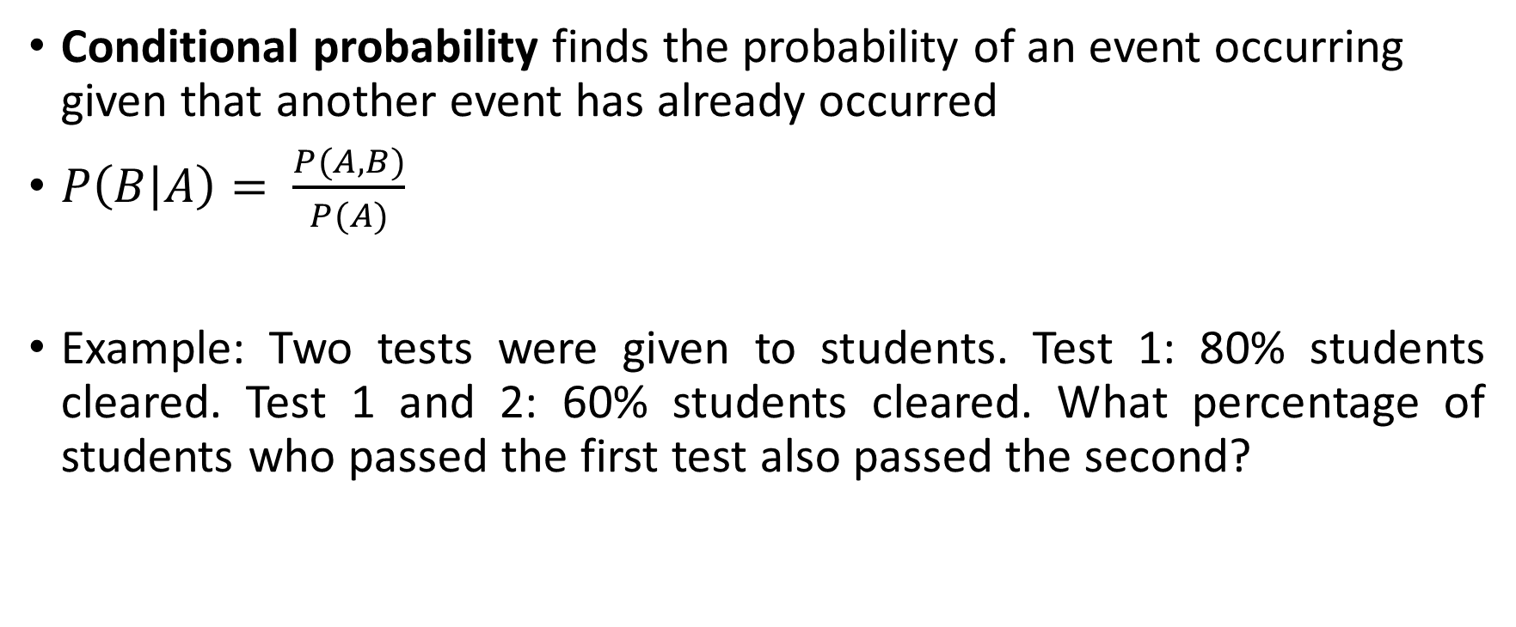
Conditional Probability
Conditional probability finds the probability of an event occurring given that another event has already occurred
$P\left(B | A\right)= \frac{P(A,B)}{P(A)}$
Example: Two tests were given to students. Test 1: 80% students cleared. Test 1 and 2: 60% students cleared. What percentage of students who passed the first test also passed the second?

Slide 49
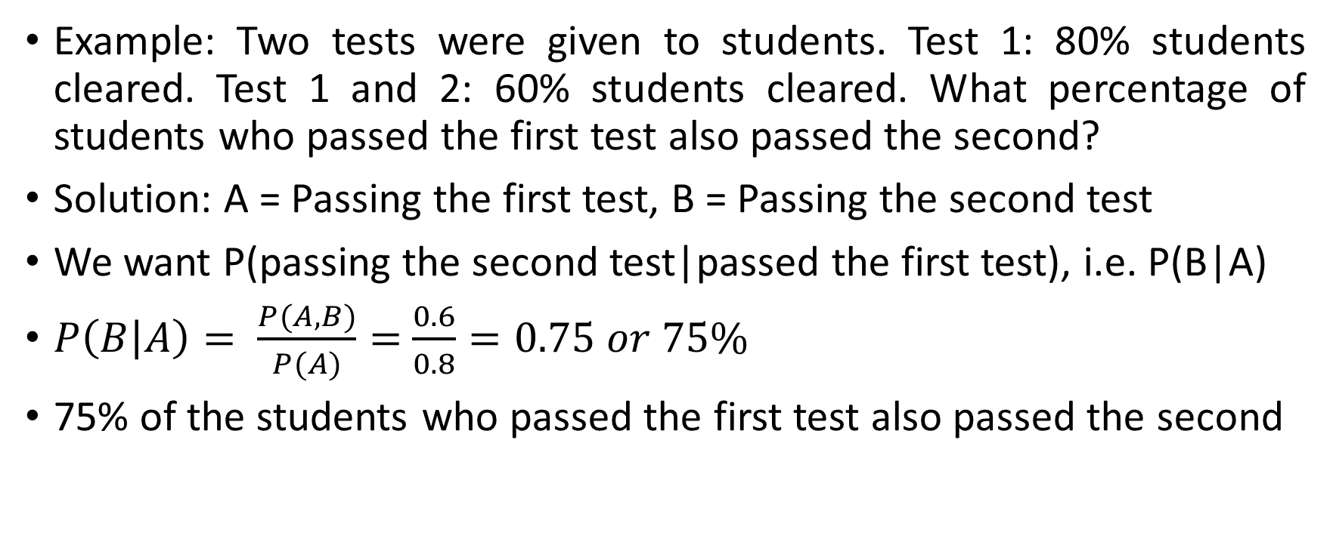
Conditional Probability Example
Example: Two tests were given to students. Test 1: 80% students cleared. Test 1 and 2: 60% students cleared. What percentage of students who passed the first test also passed the second?
Solution: A = Passing the first test, B = Passing the second test
We want P(passing the second test|passed the first test), i.e. P(B|A)
$P\left(B | A\right)= \frac{P(A,B)}{P(A)}=$ $\frac{0.6}{0.8}=0.75 or 75\%$
75% of the students who passed the first test also passed the second

Slide 50
Machine Learning Basics

Slide 51
Machine Learning
Machine Learning (ML): Enable computers to learn themselves
How? From past data
And? Adapt to new information
Advantage: No need to program them for each situation
Subset of Artificial Intelligence (AI)
Three types: (1) Supervised, (2) Unsupervised, (3) Reinforcement

Slide 52
Supervised and Unsupervised Machine Learning
Cust Id | Tr Amt | Tr Type | … | Fraud?
6789 | 10000 | Shop | … | N
1234 | 12500 | Hotel | … | Y
… | … | … | … | …
2345 | 3000 | Petrol | … | N
Cust Id | Loan Amt | Income | Emp Status | … | Default?
8901 | 25 L | 5 L | Emp | … | ?
3456 | 10 L | 8 L | Emp | … | ?
… | … | … | … | … | …
4567 | 95 L | 15 L | Bus | … | ?
Features
Label

Slide 53
Supervised Machine Learning
Labelled dataset is used here to train the ML algorithm
Scenario: Credit card fraud
Features (Inputs): Transaction amount, Transaction type, Time, Location, …
Label (Output): Fraud? (Yes/No)

Slide 54
Supervised Machine Learning Algorithms
Linear Regression: Predicting house prices based on features like square footage, number of bedrooms
Logistic Regression: Binary classification problems, like predicting whether an email is spam or not
Support Vector Machines (SVM): Image classification, text classification
Decision Trees: Customer churn prediction, classification tasks
K-Nearest Neighbors (KNN): Handwriting recognition, recommendation systems
Naive Bayes: Spam detection, text classification

Slide 55
Unsupervised Machine Learning
Unlabelled dataset is used here to train the ML algorithm
The ML algorithm discovers inherent patterns in the data without predicting output labels
Scenario: Loan default prediction
Features (Inputs): Loan amount, Income, Employment type
Output: ?
Possible solution: We will need to group similar customers into clusters

Slide 56
Unsupervised Machine Learning Algorithms
K-Means Clustering: Customer segmentation, image compression
Principal Component Analysis (PCA): Dimensionality reduction, pattern recognition
Association Rule Mining (e.g., Apriori): Market basket analysis, recommendation systems
K-Means Clustering: Customer Segmentation

